Slide 1



BIOMETRIC STUDENT ATTENDANCE
Presented by: GROUP 5

Slide 2

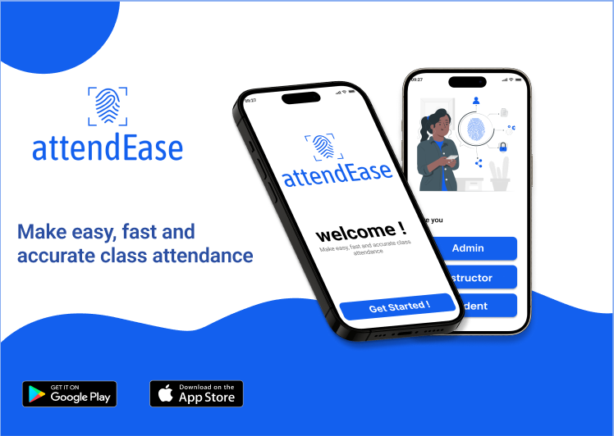


Slide 3
Database design and Implementation of the biometric student’s attendance app
Presented by: GROUP 5

Slide 4
OUTLINE
1
2
3
4
Purpose of the Database
Conceptual logical
& physical Model
Introduction
ER Diagram
5
6
7
Database
Schema
Implementation
Conclusion

Slide 5


1-INTRODUCTION
Educational institutions need accurate attendance records, and traditional methods like manual roll calls are error-prone. A biometric fingerprint recognition system offers a secure solution. The MongoDB database for the AttendEase system will store student information, fingerprint templates, attendance records, and administrative data. It will integrate with the institution's existing system for efficient data management and centralized access.

Slide 6
2. PURPOSE OF DATABASE DESIGN
Designing a database is a crucial step in the development of any data-driven application. A well-designed database provides several key benefits and fulfills multiple purposes, ensuring the efficiency, reliability, and scalability of the system.

Slide 7

2.1. Objective and use cases of the database
Use Case
Student Registration
Attendance Logging
Attendance Tracking
Management Reports

Slide 8
2.2. Key requirements and constraints
Requirements
Scalability
efficiency
user features
accessibility
Performance
Reliability
accuracy
Security

Slide 9
2.2. Key requirements and constraints
Contraints
Data Size
brainstorming
surveys
Consistency
user persona

Slide 10
3- CONCEPTUAL, LOGICAL AND PHYSICAL MODELS
Students, attendance records, fingerprint template
Conceptual Model
collection: such as students , instructors, attendance, courses.
Documents: JSON file that containt our data.
Logical Model
MongoDB document collections with indexes on key fields (e.g., student ID, timestamp for attendance records).
Physical model

Slide 11
4- ER DIAGRAM
4.1. Entities and relationships in the school
His attributes are: a unique identifier, an email, a name, and a password to secure his account.
Admin
Having attributes such as name, matricule, and email address
user features
Students
the attributes such as his name, email address, and unique identifier.
Lecturer
The attributes of a are the course code and the course title
Course
The attributes of a faculty are the faculty name and the location.
Faculty

Slide 12
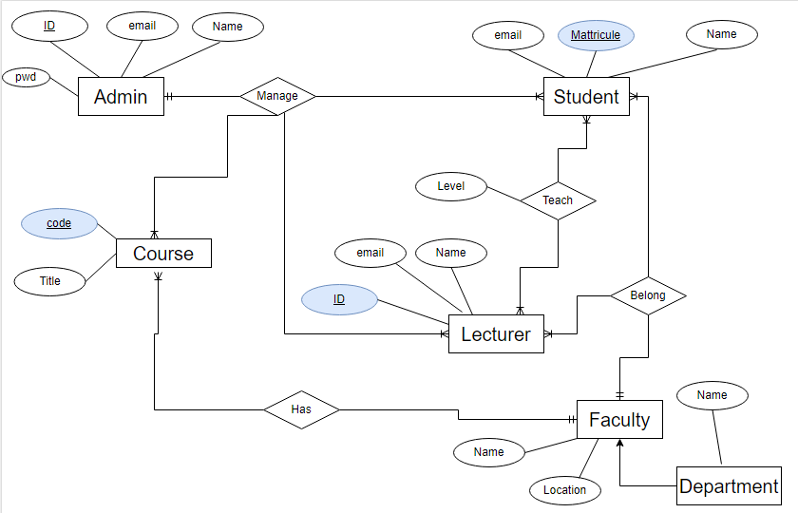
4.2. Diagram in school

Slide 13
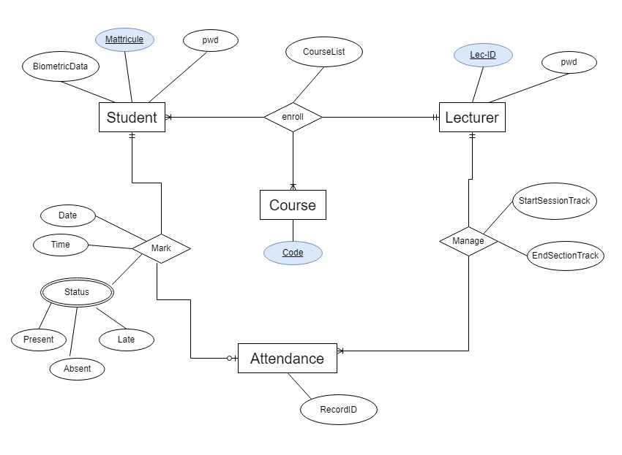
4.4. Diagram in AttendEase system

Slide 14
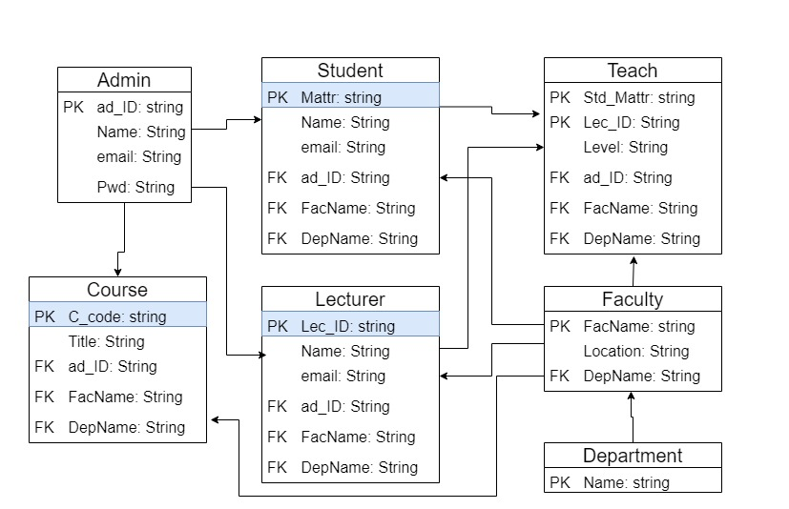
v
5- DATABASE SCHEMA

Slide 15
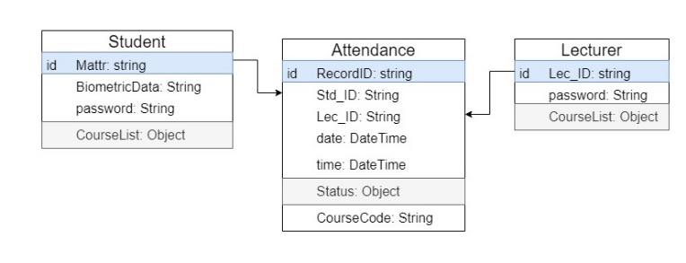
Collections and Documents in the AttendEase mobile application

Slide 16
6- IMPLEMENTATION
The implementation uses MongoDB to manage two databases:
Dependencies:
- Node.js
- Express
- MongoDB
- Mongoose
- Dotenv
- Postma
Institutional database
Application database

Slide 17
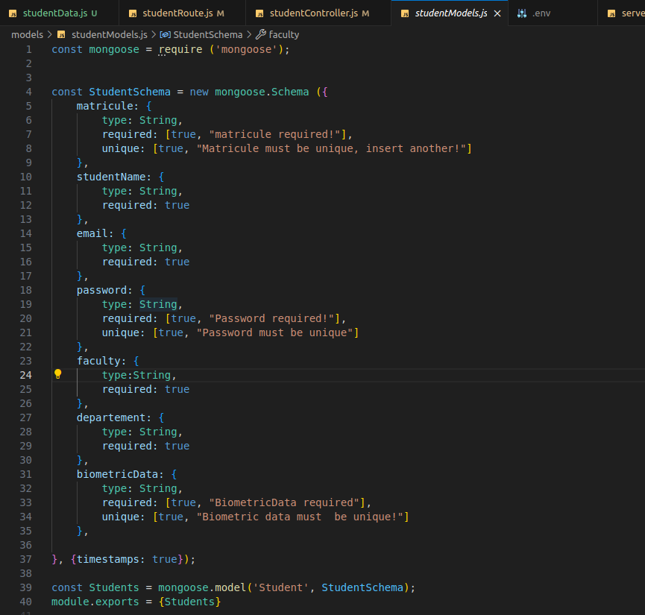
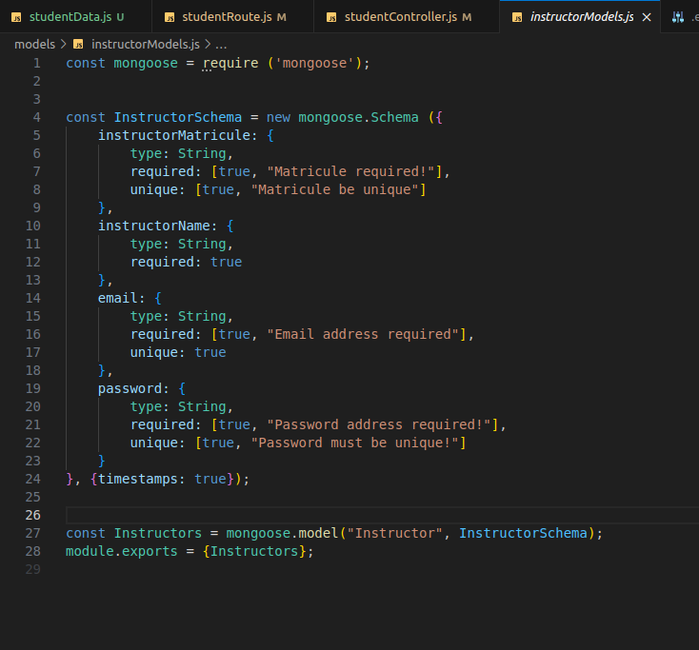
Student schema
Instructor schema

Slide 18
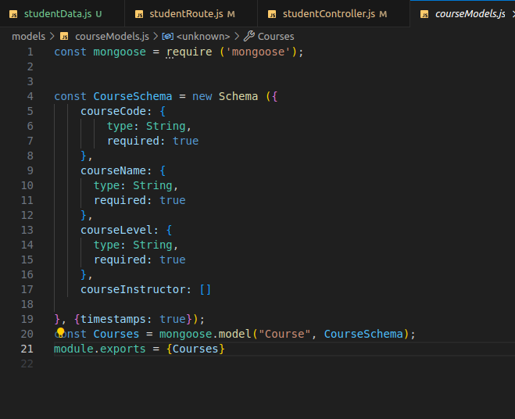
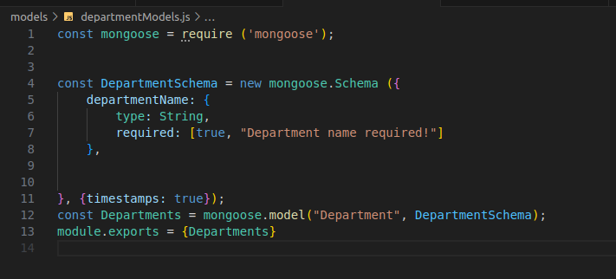
Course schema
Departement schema

Slide 19
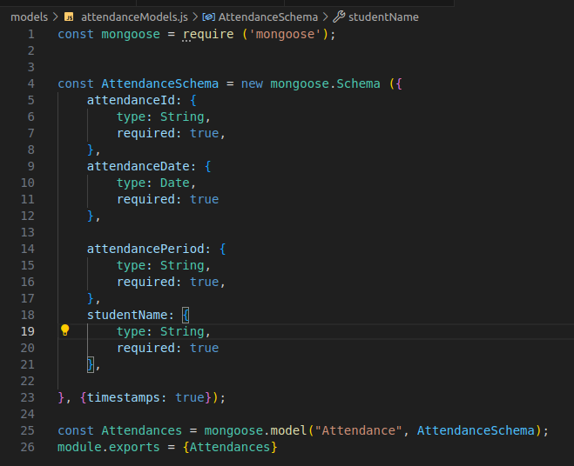
Attendance schema

Slide 20
Data insertion:
.we created the differents routes that define the endpoints for our API to determine how the application reponds to client request.
.we created controllers that contains the logic for handling requests.
.we used Postman to send POST requests to our API to insert data in our MongoDB database.

Slide 21
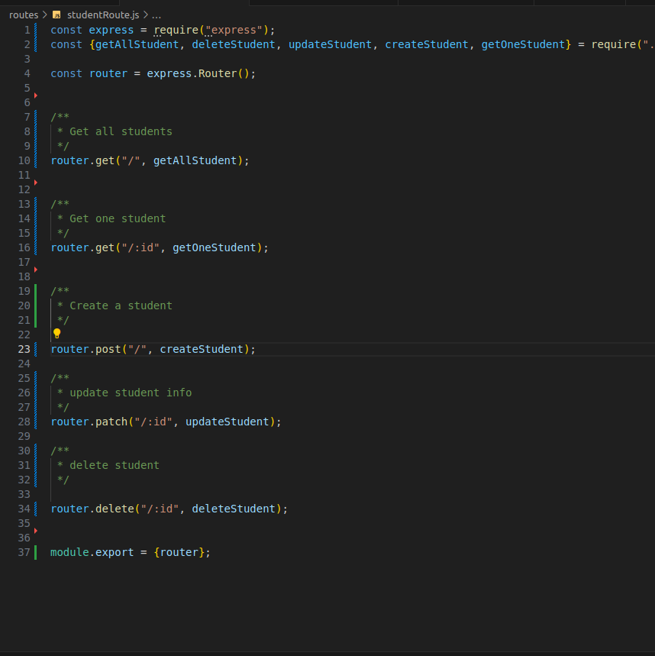
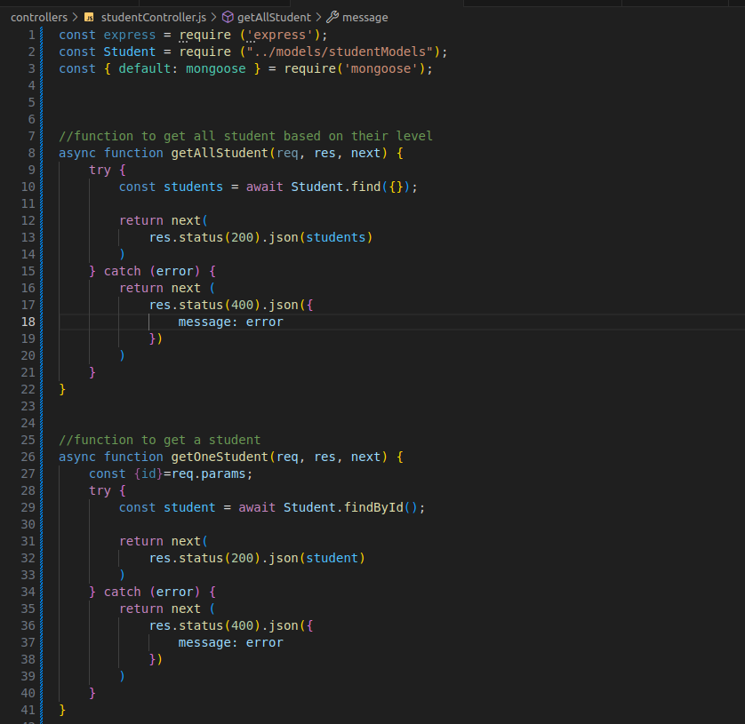
Student routes
Student controller

Slide 22


7-Conclusion
The biometric student attendance database is implemented to leverage its document-oriented structure for efficient data management. It ensures scalability to handle increasing student numbers and attendance records seamlessly. Integrated with a fingerprint recognition module, the system provides reliable and streamline biometric attendance tracking.

